Slide 1


The Development of “Pengelolaan Pendidikan” Material Based on Contextual Approach for English Students at FKIP UNJA
Nely Arif
Jambi University
Eduticon 2019
Notes:
Template ini menggunakan huruf Bebas Neue Bold dan Open Sans. Jika belum ada di komputer Anda silakan download dulu di:
https://www.fontsquirrel.com/fonts/bebas-neue
https://www.fontsquirrel.com/fonts/open-sans
Gambar2 yang digunakan didownload dari pexels.com dan pixabay.com dengan lisensi CC0.

Slide 2
AiM
to develop the “Pengelolaan Pendidikan” teaching materials in the form of Module for English students at FKIP UNJA based on a contextual approach
Eduticon 2019

Slide 3
type of research
Revelopment Research
Or
Research and Development.
Eduticon 2019

Slide 4
This development research was conducted by
A-D-D-I-E Model
A- Analysis,
D- Design,
D-Development,
I-Implementation and
E-Evaluation
Eduticon 2019

Slide 5
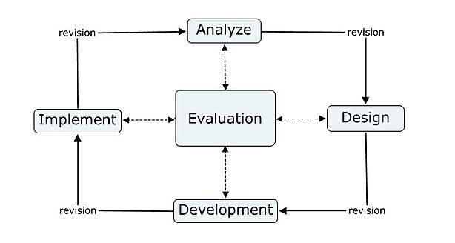

Slide 6
not all ADDIE stages will be implemented
development stage
product prototype
Eduticon 2019

Slide 7
Implementation and Evaluation phase
Next Year
Eduticon 2019

Slide 8
not all ADDIE stages will be implemented
development stage
product prototype
Eduticon 2019

Slide 9
The data in this research consist of
1
the process of developing teaching material
The reflection of the learning process of the “Pengelolaan Pendidikan” course
Documentation
the results of students’ needs taken through online questionnaire
Eduticon 2019

Slide 10
The result of...
2
interviews in limited trials
3
observation of the teaching material implementation
4
the previous teaching material analysis
5
observations of student activities
Eduticon 2019
Notes:
results of interviews in limited trials
results of observation of the teaching material implementation
idem

Slide 11
The result of...
6
the student questionnaire responses to the teaching material
7
the assessment from the validation expert
Eduticon 2019
Notes:
the results of the student questionnaire responses to the teaching material
the results of the assessment from the validation expert team regarding the quality of the teaching materials developed

Slide 12
participant
90 students at semester 6 who took the “Pengelolaan Pendidikan” course
Mardiha, 2010
online questionnaire surveys..\researchsemi\research 2019\baru\result of online questionnaure\hasil questionnaire online nely(Asli).docx
Present
Yang, 2010
Eduticon 2019

Slide 13
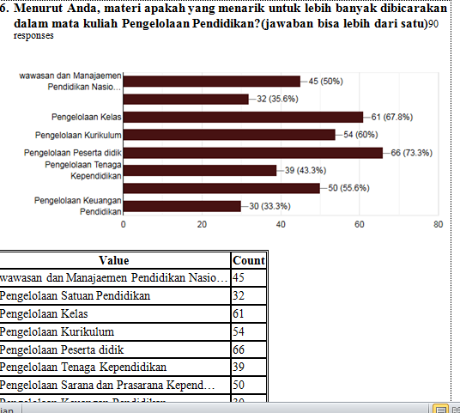

Slide 14
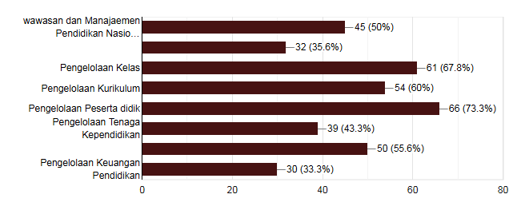
Menurut Anda, materi apakah yang menarik untuk lebih banyak dibicarakan dalam mata kuliah Pengelolaan Pendidikan?(jawaban bisa lebih dari satu)90 responses
Value | Count
wawasan dan Manajaemen Pendidikan Nasio… | 45
Pengelolaan Satuan Pendidikan | 32
Pengelolaan Kelas | 61
Pengelolaan Kurikulum | 54
Pengelolaan Peserta didik | 66
Pengelolaan Tenaga Kependidikan | 39
Pengelolaan Sarana dan Prasarana Kepend… | 50
Pengelolaan Keuangan Pendidikan | 30

Slide 15
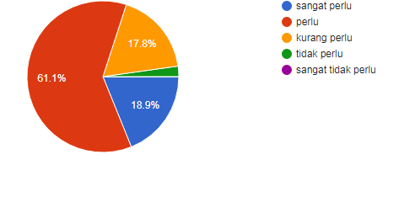
Menurut Anda, apakah Anda perlu memiliki modul dalam belajar mata kuliah "Pengelolaan Pendidikan"?90 responses
sangat perlu | 17
perlu | 55
kurang perlu | 16
tidak perlu | 2
sangat tidak perlu | 0

Slide 16
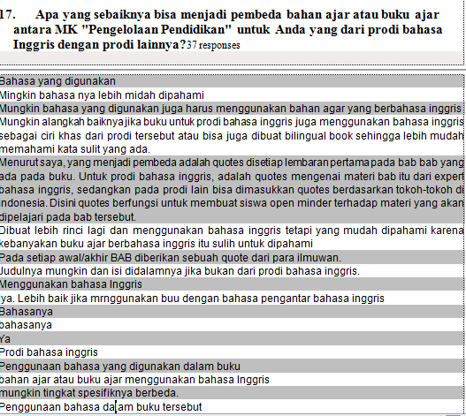

Slide 17

THANK YOU

